Slide 1
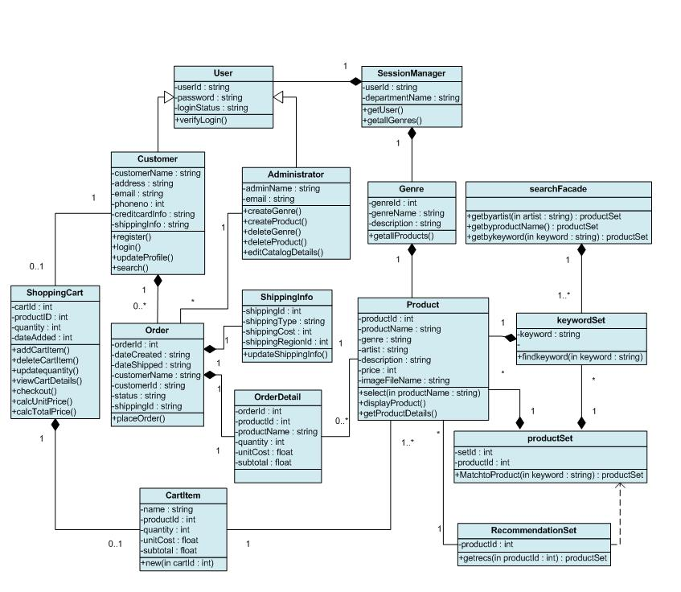


CMSC 2133 Object Oriented Programming Java
Prof. David North

Slide 2
What is an Object?

Slide 3
What is an Object?
An Object is an abstraction of a person, place or thing.
An Object can know things.
An Object can do things.
Objects do work by sending messages to other objects.
We often think of Objects as being alive.

Slide 4
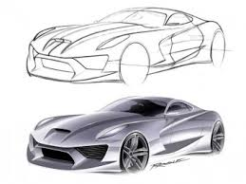
What is an Object?
A specific Car
It is a thing.
What does a car know?
What does it do?

Slide 5
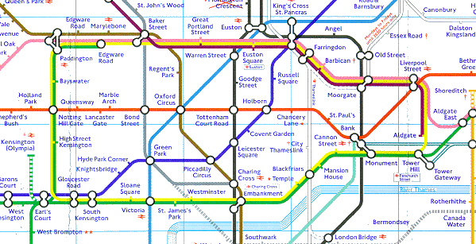
Abstraction
An Abstraction is a representation of a real thing with something that is not the real thing. Often details are left out to make it easier to user.
Real World Examples :
abstract art
Map
model
CS Examples :
representing letters as numbers
representing real word things as objects

Slide 6
What is a Class?

Slide 7
What is a Class?
It is the definition of a set of similar objects.
A Class is a template for defining and creating objects.
It has a Name.
It has a list of attributes for all objects in a Class.
It has a list of services (methods) for all objects in a Class.

Slide 8
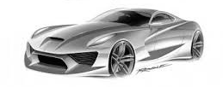
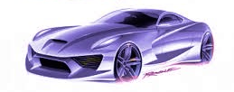
What is an Class?
What is the class for all the cars?
Name: Car (usually singular)
Attributes:
Make
model
year
color
mileage
gear
Services(methods):
start
stop
change gears
go

Slide 9
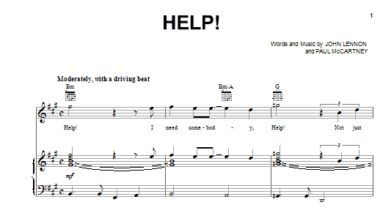
Data Representation
Data Representation is representing the information about real world data in some systematized way.
Real World Examples :
Sheet music
Braille
CS Examples :
ASCII code
Objects

Slide 10
How do we represent a Class in Java?
A Class in Java is the main way we
organize data and code.
Define - Name
Attributes
Visibility (public, private) – use encapsulation
Declare Instance variables
Services
Declare methods
Types
Constructor
Getters/Setters or Accessors/Mutators
Services
toString()

Slide 11
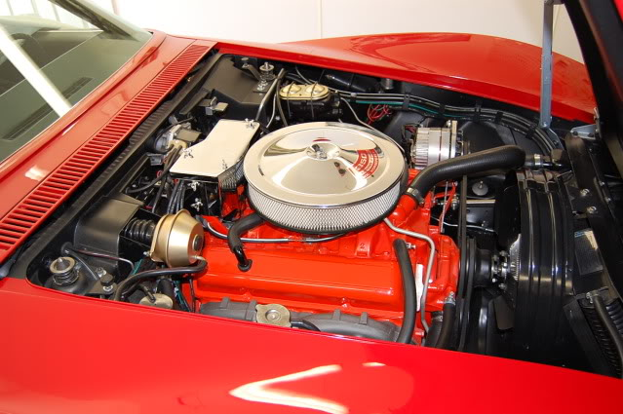
Encapsulation
Encapsulation is hiding how something works from those that use it.
Real World Examples :
A car engine
A computer
CS Examples :
Creating a function that performs a specific service.
Creating an object that knows things
Hiding how an object knows and does things

Slide 12
Problem
Car dealer needs to keep a list of his cars
What might the Classes be?

Slide 13
Unified Modeling Language (UML)
Notation for documentation of OO designs
Created by Booch, Rumbaugh, Jacobson
Lots of different diagrams defined
Use Cases
Class Diagram (Object Model)
Sequence Diagram (Interaction Diagram)

Slide 14
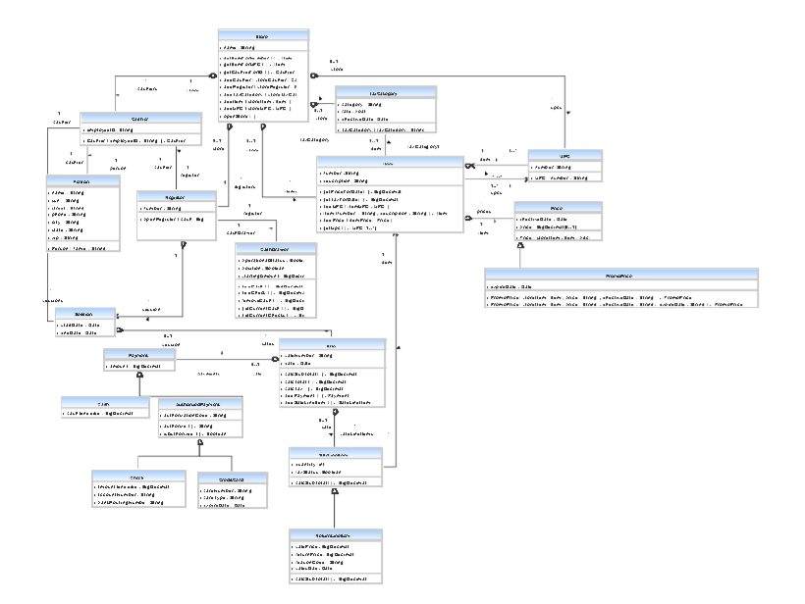
UML Class Diagram

Slide 15
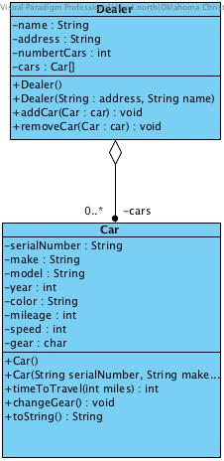
Class Diagram Notation
Class
Name
Attributes
Services

Slide 16
Associations
Associations
Association
knows about
label
multiplicity
Aggregation
has a
Parts are not deleted when the whole is deleted
Composition
is a part of
Parts are deleted when the whole is deleted

Slide 17

Tool to support development of Requirements and Design documentation
www.visual-paradigm.com
Check out
Visual Paradigm Technical Brief for install info
Visual Paradigm videos for training on using the tool.
OC has purchased a license for the CS department that all CS students can use.
We will use this for many assignments

Slide 18
Demo

Slide 19
Java Class Prog Example 5

Slide 20
Read
Chapter 5

